Slide 1
The Launch Plan
Notes:
Get to know you: Raise hand if “Thinking about Planting”, In the process right now of planting”, “Already launched”
Since you’re here, you’ve called to plant a church. God has given you a vision that is growing more exciting each day. You can’t wait to get started.
But where do you start? What’s the 1st Step, 2nd Step, 400th Step? Yes, there are 100’s of tasks needed to plant a church.
*In this session, we’ll discuss the components of the Launch Plan*
I like to plan. My wife sometimes says I like to plan too much. “Come on, it’s Saturday, do we REALLY need a detailed schedule”
I do believe that tension exists between our desires to do it on our own (I got this, I’m the man!) or to just say “I’ll take it one day at a time and WING IT”, “God’s going to do what God’s going to do”.

Slide 2
Planning is Biblical
“In their hearts humans plan their course, but the Lord establishes their steps.” Proverbs 16:9
“Suppose one of you wants to build a tower. Won’t you first sit down and estimate the cost to see if you have enough money to complete it?” Luke 14:28
“Or suppose a king is about to go to war against another king. Won’t he first sit down and consider whether he is able with 10,000 men to oppose the one coming against him with 20,000?” Luke 14:31
Notes:
I believe planning is important, WHY: It’s Biblical. God gave Noah a plan for the Ark, Moses a plan for the Tabernacle, Nehemiah a plan for rebuilding the wall in Jerusalem.
God gives you the vision in your heart – we need to trust in knowing that He will guide our steps as we develop the plan.
Planning is critical as it helps us stay focused with God’s calling and in step with HIS will for His church.
So let’s get into the steps to develop a Launch Plan.

Slide 3
Launch Plan Questions
Why are you planting?
Whom are you trying to reach?
Where will the church will be located?
How much will it cost?
How will it be funded?
What kind of church it will be?
What staff & volunteers will be needed?
How will you build critical mass?
Notes:
First, you need to reflect on all these questions that you will want to address in your Launch Plan.

Slide 4
The Right Amount of Planning
Notes:
In addition to the practical “how to” I’ll give you today on Planning, I hope you’ll take away this graph.

Slide 5
Launch Plan Purpose
Provides Clear/Concise/Written Plan
Focuses Your Vision
Fundraising Mechanism
Recruiting tool for Launch Team
Allows for feedback from mentors
Priority Setting
Setting Expectations to Monitor Progress
Notes:
1. Focusing Your Vision - You don't really understand something unless you can write it down. The process of writing a launch plan will help you refine your vision and learn to communicate it more effectively.
2. Fundraising Tool - MONEY follows vision. The written launch plan is a tool for opening the door for conversations with potential donors.
3. Recruiting Tool - Your launch plan is a great tool for recruiting potential launch team members.
4. Feedback - You launch plan can be reviewed by other experienced planters and leaders. Been there, Done that!
5. Priority Setting - Developing an action checklist will help you prioritize your time. Sideways energy occurs when you don’t have priorities set.

Slide 6
Launch Plan Components
Narrative
Description of the Picture of Opening Day
Breakdown of Key Strategies
Defining the “Win”
Action Checklist (Integrated Schedule)
Tasks
Start/Due Dates
Budget
Assignments
Notes:
Opening Day: What will it look like. What “experience” will people have on Sunday morning. What ministries will be available.
Define “The Win” in terms of both short and long range measureable goals for the new church.
Examples:
Launch Team size at various points in the launch process
Expected attendance at Launch
# of small groups in place at Launch
Points at which staff will be hired
Expected date the new church will be self-sufficient

Slide 7
Sample Launch Plans
Notes:
Here are the covers of some sample Launch Plans.
Ensure they are colorful, eye-catching to make someone want to open it up and read it. And maintain eye-catching readability throughout the document.
Remember the “customer” readers are potential donors and potential Launch Team members so this plan needs to be compelling.

Slide 8
The Planning Process
Step 1: Start with the END in Mind
Step 2: Develop Strategies
Step 3: Grouping and Sequencing
Step 4: Scheduling
Step 5: Budgeting
Step 6: Assigning Tasks
Notes:
This is the 6 Step Planning Process
Let’s cover each of these in some detail.

Slide 9
Planning Process (cont.)
Step 1: Start with the END in mind!
“To begin with the end in mind means to start with a clear understanding of your destination. It means to know where you’re going so that you better understand where you are now and so that the steps you take are always in the right direction.”
Stephen Covey
7 Habits of Highly Effective People
Notes:
Once you have a clear picture of the end (opening day), you can begin the planning process working “Right to Left” meaning starting with Opening Day and working backwards with planning details to today (or when you plan to get started).
When going Left to Right, a planter will conclude that they simply can't get everything done by launch day. So they then change the date, or eliminate actions/tasks/
Right to Left planning helps the planter to stay purpose driven with a constant eye toward a healthy opening day.

Slide 10
Planning Process (cont.)
Step 1: Start with the END in Mind
Step 2: Develop Strategies → Launch Plan Narrative
Prayer Team
Fundraising
Demographic/Contextualization
Marketing
Outreach/Service
Discipleship/Assimilation
Staffing
Finance Plan (Budget)
Ministry Teams/Systems & Processes
Facility
Equipment
Purpose > S.M.A.R.T. > Tasks
Goals
Notes:
STEP 2:
Eventually, you’ll want a written PLAN for some of these strategies, but start FIRST with a purpose statement (1-3 sentences) for each of these. Each purpose should clearly tie back to why this new church vision/mission.
After defining a clear purpose, identify 3-5 key goals that need to happen for the purpose to be fulfilled.
SMART: Specific, Measureable, Attainable, Relevant, Timely
After defining key goals, identify specific tasks needed to accomplish each objective.
Example task may be to generate a list of marketing tools (i.e. flyers, direct mail cards, radio advertising, etc.) the church will use.

Slide 11
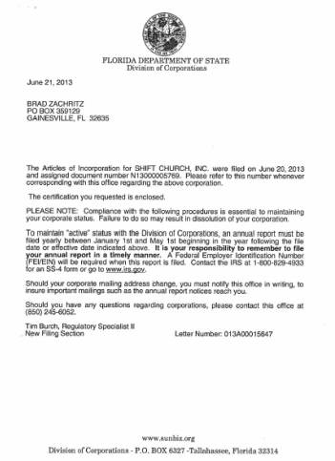
Planning Process (cont.)
Step 1: Start with the END in Mind
Step 2: Develop Strategies
Step 3: Grouping and Sequencing
Articles of Employer ID 501c3 Sales Tax
Incorporation Number (EIN) Status Exemption
Notes:
STEP 3:
Grouping and Sequencing is also important.
Grouping
Look for logical groupings of actions to designate as milestones. For example, the 6-8 actions required to obtain 501(c)(3) status may be linked to a milestone called “Organizational Establishment”.
Sequencing
Identify the relationships between tasks and note which tasks need to be finished before or after others. If necessary, draw the relationships on a White Board so the dependencies are easy to see.

Slide 12
Planning Process (cont.)
Step 1: Start with the END in Mind
Step 2: Develop Strategies
Step 3: Grouping and Sequencing
Step 4: Scheduling
Notes:
STEP 4 - Scheduling
Before working for P4P, I worked for The Boeing Company for 15 years
Pictured here is the Aircraft Manufacturing plant at Boeing for the 737
This is a Continuous Movement assembly line.
The 737 production line moves at a rate of about 2 inches per minute.
Aircraft produced every 6 days
So scheduling was a BIG deal on this assembly line to ensure we had all the right parts and people in place at just the right time. If LEFT wing shows up late – not fly on that plane – too early, where are you going to store it?
It’s the same in the Church Planting Planning Process.
Great example is Sound & AV Equipment
You need Sound & AV Equipment for your preview service
Takes time to plan, process, fill and deliver your order
Need to have the task of ordering this Sound & AV Equipment on the schedule earlier enough so it will be delivered in time for your 1st preview service.

Slide 13
Planning Process (cont.)
Step 1: Start with the END in Mind
Step 2: Develop Strategies
Step 3: Grouping and Sequencing
Step 4: Scheduling
Step 5: Budgeting
Step 6: Assigning Tasks
Notes:
STEP 5: Budgeting
Now that we have the tasks identified and know how long we can expect each task to take, we need to identify the cost for each task. Time and Materials are the are the cost component. Yes a lot of the time is no cost as it’s volunteers, but there are time costs like for your coach. And of course materials costs need to be carefully planned –some are BIG – like AV equipment.
CASH FLOW is huge – so having a schedule-based budget will also tell you WHEN you need the money.
STEP 6: Assigning Tasks
Remember: You CAN’T do it all yourself! Assign the responsibility of the task to individuals. In reality, you as the church planter are overall responsible for them
This is a good time to establish your Culture of Delegation and be willing to release tasks to folks on your Launch Team.

Slide 14
Executing the Plan
Milestones
Tasks
What
How
Coaching Checkpoints
Notes:
Milestones
Milestones (logical groupings of tasks) are great checkpoints to monitor progress in executing the plan.
Tasks we talked about early can be broken down into the “what” and the “how”
What: Obtain 501(c)(3) status
How: Download the latest Form 1023 from the IRS, complete attachments, draft cover letter, send in package with check.
Coaching: Can’t say enough how important it is for the Church Planter to have a coach. The Launch Plan should have checkpoints for open/honest discussions with your coach. Examples include:
Review/Affirm Opening Day Expectations
Review/Affirm Fundraising Plan

Slide 15
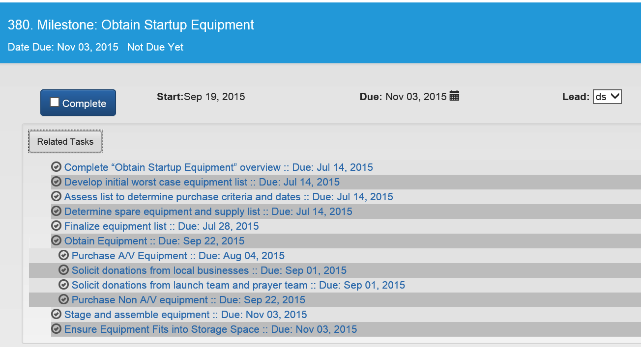
Milestones and Tasks (what)
Group & Sequence Tasks
Notes:
Here are some screen shots from our project management tool called PlanterPlan to show examples of the concepts of Milestones, Tasks, Grouping & Sequencing of Tasks that we just talking about.

Slide 16
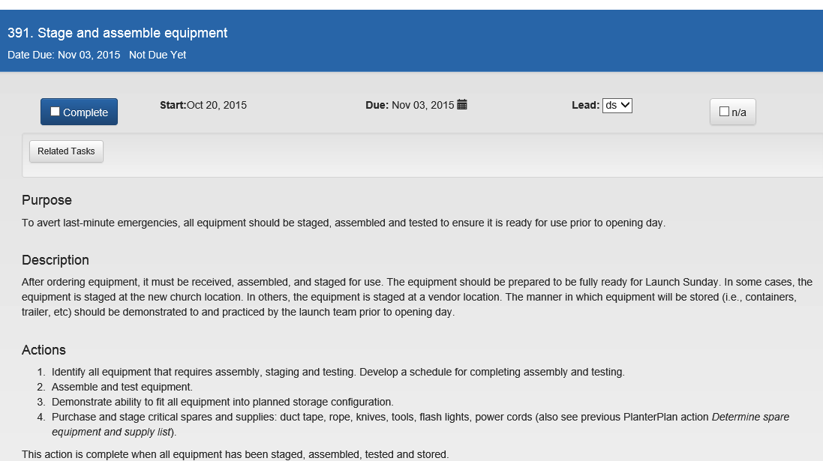
Tasks (how)
Assign Tasks
Schedule Tasks
Notes:
Here we have a sample task broken down by:
Purpose
Description
Action Steps (the HOW TO)
We also have the final parts of the 6 Step Planning Process which is Scheduling and Assigning Tasks.

Slide 17
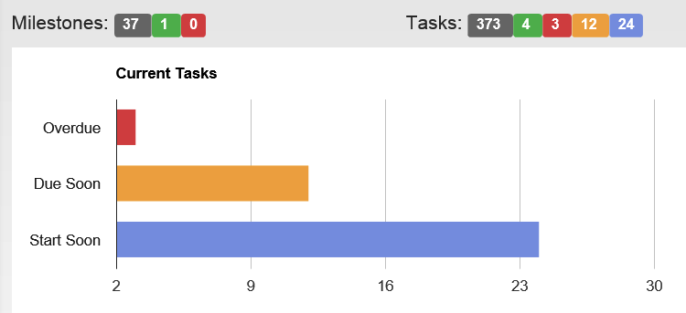
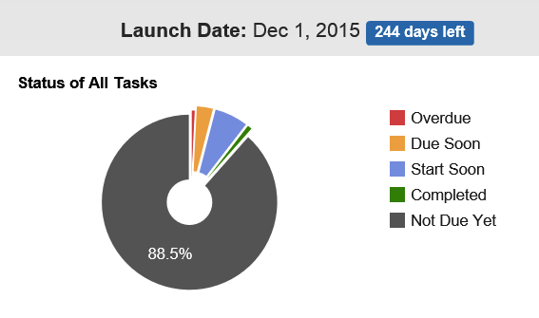
Reporting Results
Milestones Due in Next 30 Days
ID | Name | Priority | Due Date
269 | Milestone: Connect through Social Media | 2 | 12/06/2014
386 | Milestone: Develop Worship Planning System | 2 | 12/17/2014
161 | Milestone: Complete State Legal Requirements | 1 | 12/24/2014
Milestones Overdue
ID | Name | Priority | Due Date
300 | Milestone: Implement Discipleship Plan | 1 | 11/13/2014
 | Note: 1 of the 3 tasks within this milestone is complete. The remaining two tasks are related to conducting small group leader training and establishing the first small group. Anticipate small groups being rolled out closer to launch.
310 | Milestone: Implement Assimilation Plan | 1 | 11/18/2014
 | Note: 2 of the 3 tasks within this milestone are complete. The remaining task is scheduling post-launch newcomer gatherings. The planning for these gatherings is complete.
Notes:
You need to Report Results to who you are Accountable to:
-Recommend Monthly Status Reports to keep Management Team up to date on the status of the Launch Plan.
Work together with Management Team to understand what they want to know monthly, but here are some recommended examples.
You should also include a bullet list of the Significant Accomplishments for that month!

Slide 18
Managing the Project
Fact: You don’t have the bandwidth to do it all
Someone needs to keep the project on plan
Delegate tasks but keep the “big picture”
Get help with Project Management
Leverage expertise of Launch Team
Contract out PM services
Proper balance frees time for planter to focus on people and vision
Notes:
BANDWIDTH: Remember typical church plant process has over 400 steps!!!!
Does no good to have a plan if nobody is making sure we are on plan.
Someone needs to act as project manager. This person will keep close watch on the plan and actual progress to make sure that all effort contributes to the stated goals for the new church.
God may provide someone on your Launch Team that has PM experience or is good with details.
Don’t forget Your spouse may be a great Project Manager.

Slide 19
Tools
Microsoft Project
Microsoft Excel
New Church Planning Checklist
Basecamp, CreativePro, LiquidPlanner, and other online tools
PlanterPlan (by Passion for Planting)
Full Functionality Project Management Tool
Milestones, tasks, checklists, templates and samples all specific to starting a new church
Notes:
You need to have a tool to manage the hundreds of tasks you’ll be completing to plant a church.
Here are some example tools. Traditional and non-traditional
On our P4P website under Free Resources you can download our New Church Planning Checklist which is in MS Excel format (provides the “what” not the “how”.)
In your chair you have a flyer on our PlanterPlan tool.

Slide 20
Summary
Having a documented Launch Plan will:
Lower risk
Reassure donors
Attract/Retain Launch Team members
Keep Vision in focus
Serve as an Historical Record
Beginnings of a plan for the next Church Plant

Slide 21
Contact Information
Pat Furgerson & Dale Spaulding
patf@church-planting.net
dales@church-planting.net
703-817-0601
www.church-planting.net
Download Free Sample Launch Plans

